Slide 1
Amazon Fresh Analytics

Slide 2
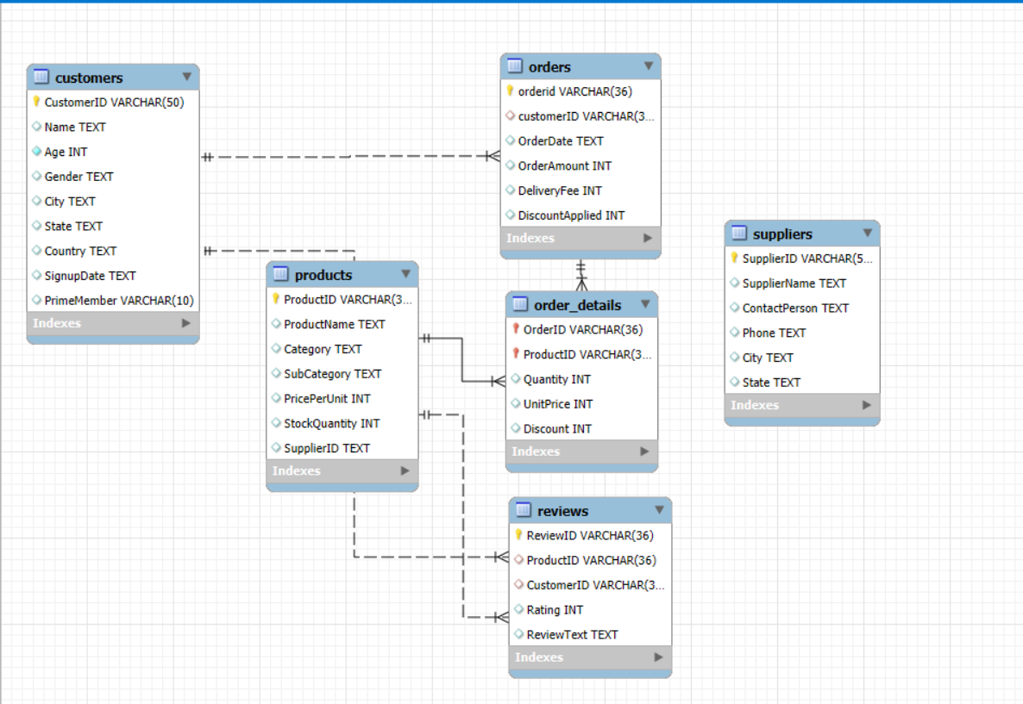
TASK 1
ER diagram
“Customers place orders, orders contain products, suppliers provide products, and customers review products.”

Slide 3
Identify the primary keys and foreign keys
TASK 2
Each table has a Primary Key that uniquely identifies its records.
Relationships are maintained using Foreign Keys.
Table | Primary Key | Foreign Key(s)
Customers | CustomerID | –
Orders | OrderID | CustomerID, ProductID

Slide 4
Basic Queries
TASK 3
🔹 Query 1: Customers from a specific city → Retrieved 3 customers from Christopherland
🔹 Query 2: Products under “Fruits” category → Retrieved Multiple fruit items
NOTES;
“Since the Products table was normalized in Task 12, filtering by Category/SubCategory is done through JOINs with the Category tables instead of directly from Products.”

Slide 5
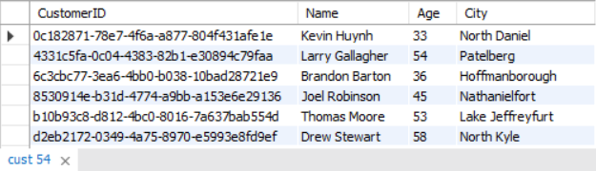
Data Definition Language (DDL) and Constraints
TASK 4
DDL statements to recreate the Customers table
Added Primary Key: CustomerID
Added Check Constraint: Age > 18, NOT NULL
Added Unique Constraint: Name

Slide 6
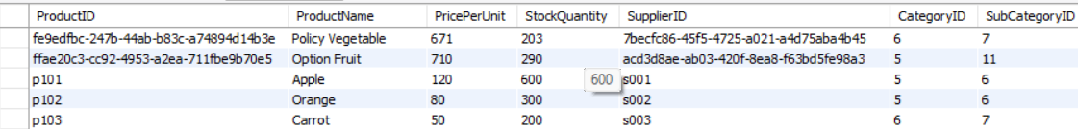
Data Manipulation Language (DML)
TASK 5
INSERT
Inserted 3 new rows into Products table.
Example products: Apple (Fruit), Carrot (Vegetable), orange (Fruit).

Slide 7
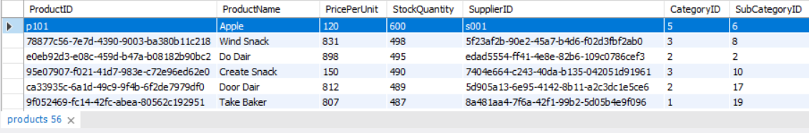
TASK 6
Update
Updated stock for ProductID = P101.
Old Stock: 500 → New Stock: 600.

Slide 8
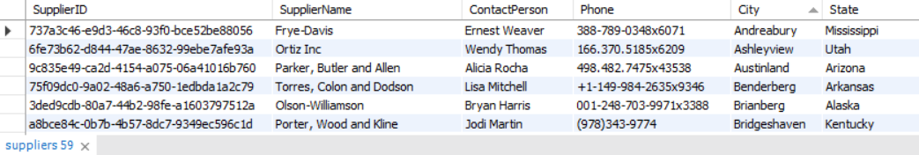
TASK 7
Delete a Supplier
Deleted supplier where City = Allenfurt.
Example: Supplier “FreshFoods Pvt Ltd” removed.

Slide 9
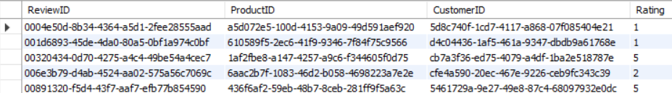
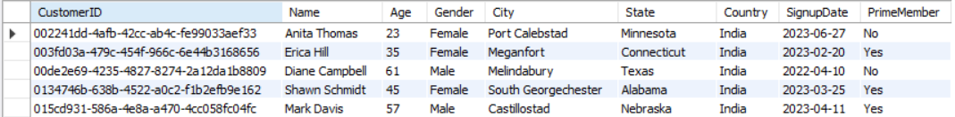
SQL Constraints and Operators
TASK 8
WHERE /WHERE /GROUP BY/ORDER BY
CHECK constraint → Rating must be between 1 and 5.
DEFAULT constraint → PrimeMember defaults to “No”.

Slide 10
Clauses and Aggregations
TASK 9
These queries combine to give customer trend analysis:
WHERE → Recent orders → latest trends.
Insight: Helps us focus on latest sales trends instead of old data.
HAVING → Highly rated products → customer satisfaction.
Insight: Identifies customer favorites → useful for promotions, recommendations.
GROUP BY + ORDER BY → Best-sellers → revenue drivers.
Insight: Reveals best-selling products → useful for stock management & business strategy.

Slide 11
TASK 10
Identifying High-Value Customers
Calculated spending per customer.
Insight: Shows each customer’s contribution to revenue.
Ranked customers by total spending.
Insight: Reveals the most valuable customers to the business.
Identified customers with > ₹5,000 spend
Insight: Helps Amazon Fresh create loyalty programs, discounts, or premium services for high-value customers.

Slide 12
Complex Aggregations and Joins
TASK 11
Joined Orders + OrderDetails → calculated revenue per order.
Found customers with most orders (Jan–Mar 2024).
Identified supplier with highest stock.

Slide 13
Normalization (3NF)
TASK 12
Split Products table into Products, Categories, Subcategories.
Removed duplicate/redundant data.
Linked tables using Foreign Keys.
NOTES:
“After normalization, Category and SubCategory are moved into separate tables, and the old columns are no longer used in the Products table.”

Slide 14
Subqueries & Nested Queries
TASK 13
Found Top 3 products by sales revenue.
Identified customers with no orders.
Insights
Shows best-selling products for promotions.
Helps target inactive customers with offers.

Slide 15
Real-World Analysis
TASK 14
Found cities with highest Prime members.
Identified Top 3 ordered categories.
Insights
Prime members are concentrated in major cities.
Fruits, Meat, Snacks are most frequently ordered.

Slide 16
THANK YOU

